Slide 1
What need to be changed and what happens when it is changed
PhD. Ann-Christine Andersson Arntén
National Board of Police, Sweden

Slide 2
Studies on what need to be changed and what happens when it is changed.
Interview studies (45 participants)
Survey study (617 participants)

Slide 3
Gap between what is done and what is said to be done!
©A-C Andersson Arntén

Slide 4
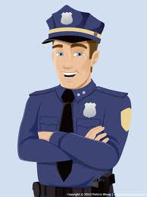
Political correctness
Participation – important
(when I want to, how I want to, and on my conditions)

Slide 5
What we have Top-down decision and goal-settings
What we need Learning environment - decision and goal-settings from bottom to top.

Slide 6
continuance commitment
normative
commitment
Resignation
internal regulation
(motivation from own goal or interest)
positive
affect
negative
affect
intrinsic motivation
enthusiasm
vitality
Generate positive impact Generate negativ impact

Slide 7
energy
emotional
commitment
concentration
internal regulation
(motivation from own goal or interest)
vitality
positive
affect
intrinsic motivation
Possibilities to develop
continuance commitment
Generate positive impact Generate negative impact

Slide 8
What happens when we change?

